Slide 1
Enhancement Security in Decentralized Finance (DeFi): A Web3 Paradigm
Sai Charan Modugula
Notes:
Introduce yourself
State the title of your research paper

Slide 2

Problem Statement
Primary Security Concerns
Reentrancy Attack
Malicious actor withdraws funds before initial transaction settles, exploiting contract state
Front Running Attack
Exploits public mempool, inserting transaction ahead for personal gain
Notes:
Add important points here

Slide 3
Research Methodology
Investigative Approach
Security enhancements strategies for DeFi
Examined case studies of DeFi platforms
Tool Analysis
Investigated available tools and methods
Sought for both static and dynamic analysis
Synthesis and Recommendations
Collated and critically analyzed information
Formulated set of recommendations
Notes:
Add important points here

Slide 4
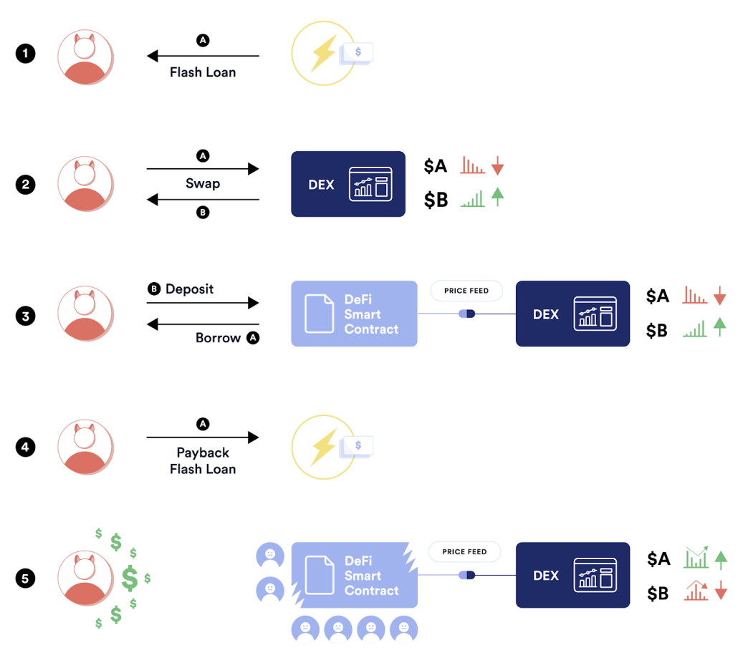
Results and Findings
Uncovered Key Vulnerabilities
Oracle Manipulation
Vulnerability detection Tools
Static and Dynamic Analyzers
Enhancement Strategies:
ML based Byte Code Analysis
Security Frameworks
Collaborative learning framework by Khoa et al in
26 March, 2024
94% accuracy detection while 2,150 transactions per second
Notes:
Add important points here

Slide 5
Summary and Conclusions
Today’s DeFi’s Security challenges.
Robust and well-rounded security approach.
Collaborative Learning Framework.
Scalable Security Maintenance.
Non-Touring Computational Systems.
Notes:
Add important points here

Slide 6
Thank You
Notes:
Remember to stop the timer when it goes off.
Ask the audience if there are any questions.

